Slide 1

Training Convolutional Neural Networks on MNIST
Benjamin Talbot 3574678
Final Project – CS 4795 Intro to AI
Notes:
Decided to apply CNNs to OCR using the MNIST dataset

Slide 2
Scope and Purpose
Interested in Machine Learning
CNNs very good at image recognition
Weights and biases + Feature extraction
Experimented with CNN hyperparameters and layering
Created my own CNN
Tried two improved implementations
Notes:
CNNs good at anything that can be modeled as an image
CNNs have, just like typical NNs, weights and biases, but they also have the ability to perform feature extraction using a process I’ll describe later
My purpose in developing this project was to learn about CNNs, fool around with them to get experience, and learn good ones

Slide 3
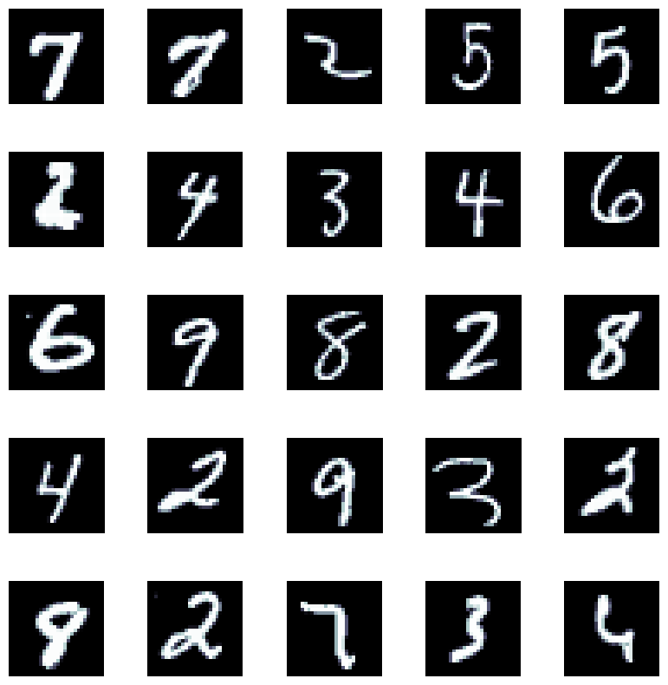
MNIST
28x28 grayscale, i.e. single channel input (vs. color)
60,000 train
10,000 test

Slide 4
What is a CNN?
Convolution layers
Subsampling (pooling) layers
Filters
Activation function
Hyperparameters
Notes:
Convolution layers: essentially what extracts the features
Subsampling/pooling: reducing the size of the feature maps while keeping depth (# channels) for faster processing
Filters: features that get applied to the image to produce feature maps as output
Activation function: same idea as before basically, but typically ReLU, also tanh
Hyperparameters:
Convolution:
# features
Kernel size
Stride
Pooling:
Window size
Window stride
Fully Connected: # neurons

Slide 5
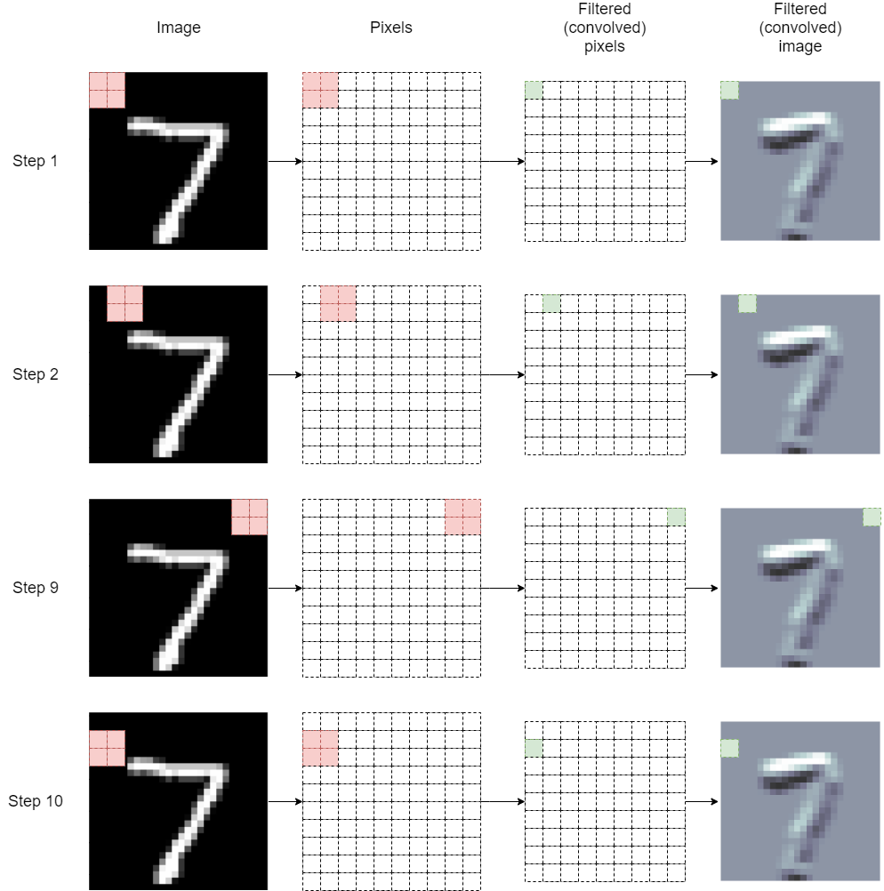
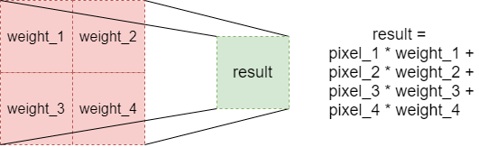
Convolution
Notes:
Extracts features
Overlap filter, multiply corresponding entries, sum
Filters provide features that convolution checks against the image
Stride
How do you pick the filters? - you don’t --> learned through backpropagation
Padding, usually black pixels

Slide 6
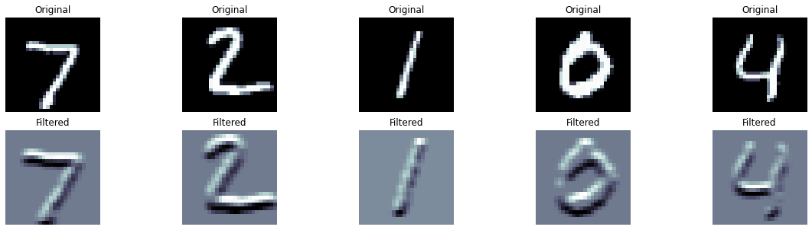
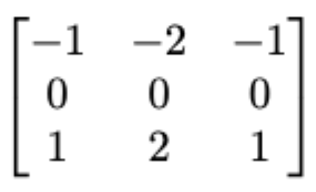
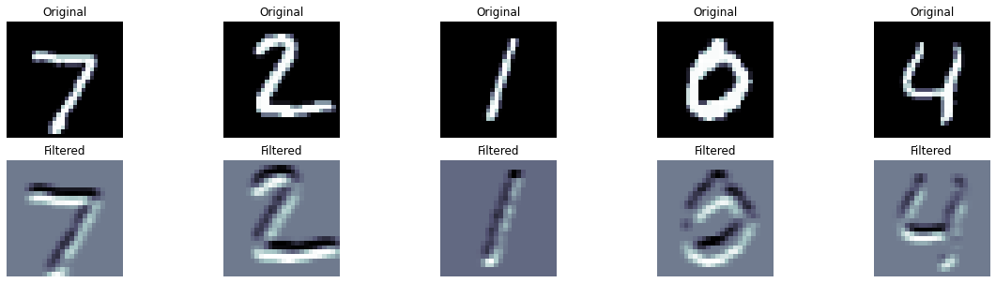
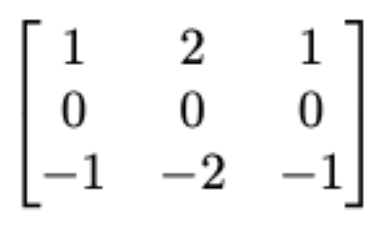
Feature
Extraction
Notes:
Sobel (Soh-bell) Operators – edge detection (contrast colors)
These are horizontal, with top being dark to light (top down)
Bottom light to dark
Horizontal, vertical, diagonal depending on rotation of matrix

Slide 7
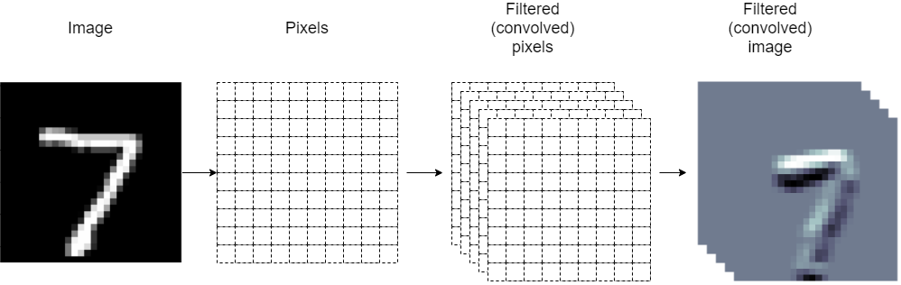
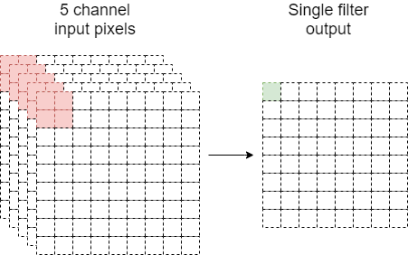
Filter Layers
Notes:
Can have multiple layers, or channels
Multiple filters are applied to the input image to produce several output images
With multiple input layers, would apply each filter to each layer, producing a single outut
Can combine multiple layers again to produce multiple output channels

Slide 8
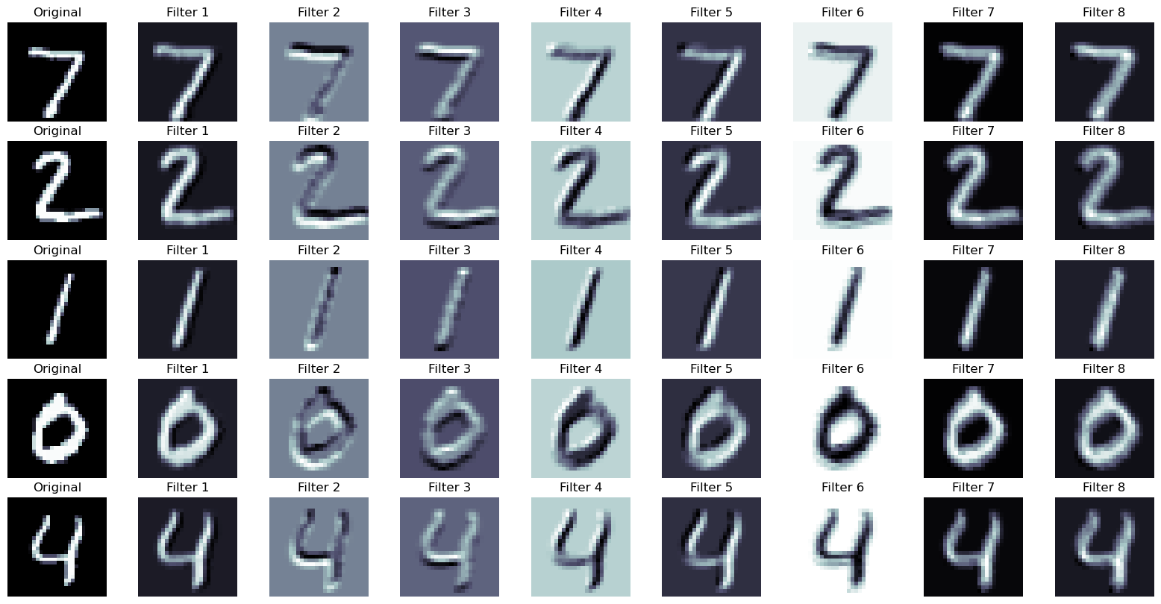

Filtered
Digits
Notes:
Examples of filtered images, along with the corresponding filter

Slide 9
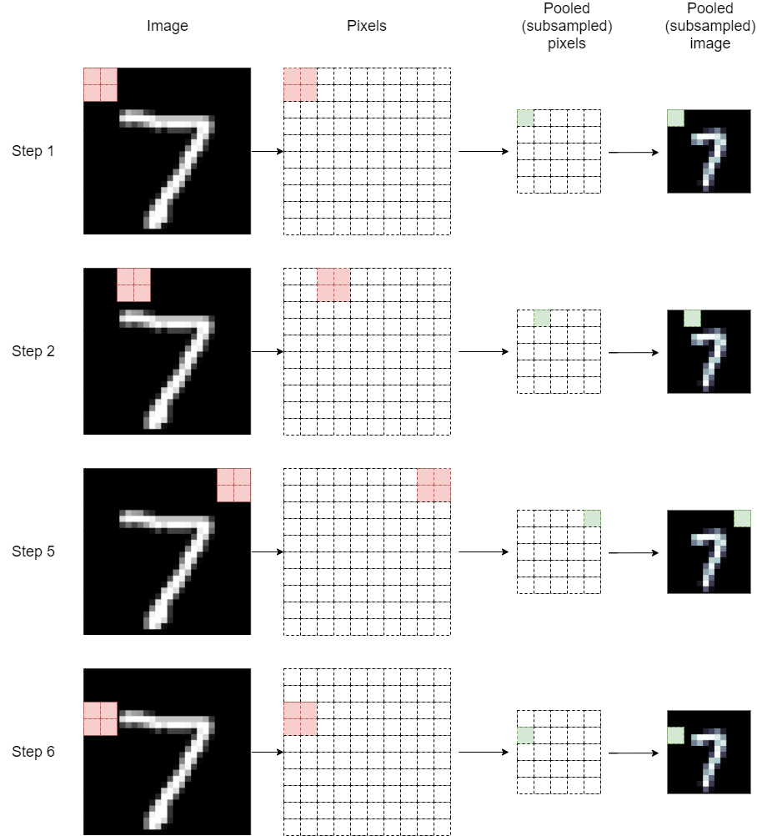
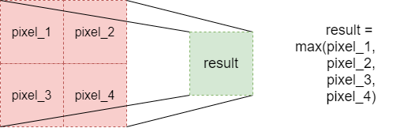
Subsampling
Notes:
Aka pooling
Both max and average
reducing the size of the feature maps while keeping depth (# channels) for faster processing
Not applied across layers, keeps the features “intact"

Slide 10
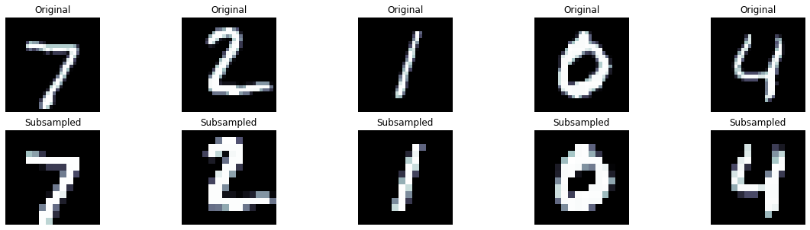
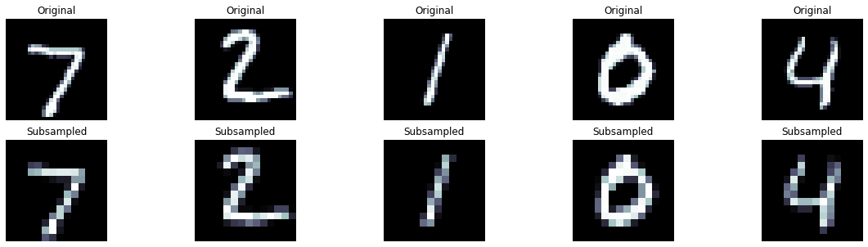
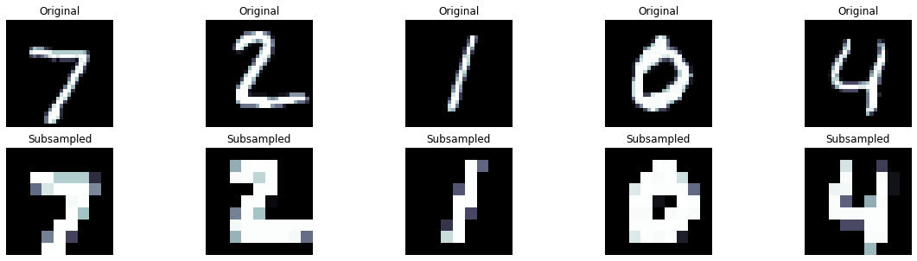
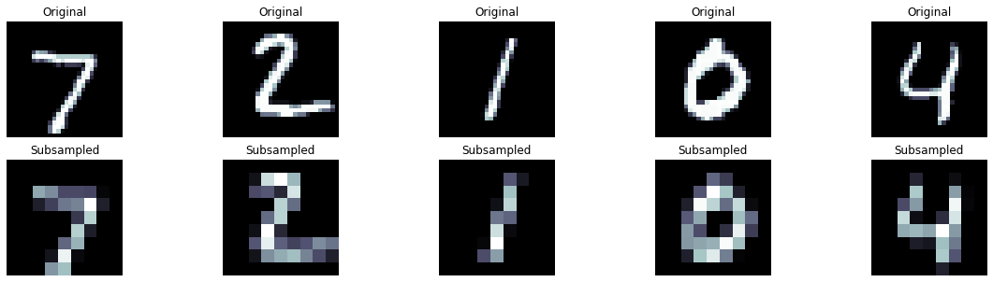
 | Max | Average
Smaller Filter
Bigger Filter
Notes:
Examples of the effects of subsampling applied to a given image

Slide 11
Interesting Implementations
LeNet-5
784 - [32C3-32C3-32C5S2] - [64C3-64C3-64C5S2] - 128 – 10 with 40% dropout, batch normalization, and data augmentation added
Notes:
LeNet-5 by Yann LeCun in 1998
Second is one that was tried and tested to find “best” one
32C3 – 32 feature maps, 3x3 kernel, step 1
P2 – 2x2 kernel, stride 2
256 – fc layer

Slide 12
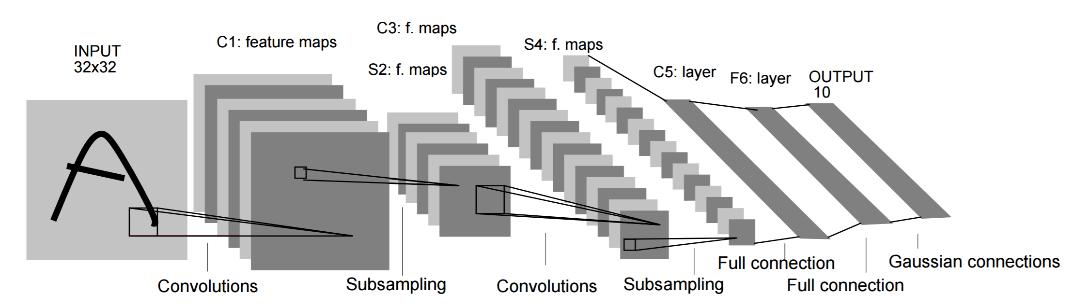
LeNet-5 Architecture
Convolution: 5x5 kernel, stride=1, 0 padding
Pooling: average, 2x2 kernel, stride=2
Notes:
Convolution: 5x5 kernel, 1 step, 0 padding
Pooling: avg 2x2 kernel, 2 step
32x32 C→ 28x28x6 P→ 14x14x6 C5→ 10x10x16 P→ 5x5x16 C→ 1x1x120 Flat→ 120 fc units → 84 fc units → 10 output classes

Slide 13
Comparison
My ideas: experiment with models, trying to find hyperparameters and layering that worked well
Other ideas: researched/tested, so found hyperparameters, layering, and techniques that worked very well
Performance

Slide 14
Results
Model | My Implementation | LeNet-5 | Greg Hogg’s | Best on Kaggle | Best Found in Literature
Accuracy (%) | 98.71 | 99.06 | 99.2 | 99.75 | 99.89
Notes:
Best on Kaggle: experiment with different layers, hyperparameters, combining multiple together (15)
Best found in literature: experiment with different layers, hyperparameters
Skeptical about higher values: some data impossible to recognize, mislabeled inputs
Striking successes: high accuracies, confusion matrices, t-SNE-plots
Striking failures: wrong guesses. Pca plots

Slide 15
Can we do Better?
Could experiment with adding/removing layers, adjusting kernel size/#filters, etc.
Different type of layer?
Usually have lots of data (+data augmentation)
But CNNs already perform very well
What about small amounts of data?

Slide 16
Conclusion
CNNs are fascinating, interesting, accurate, and useful
Were a major step forward in Machine Learning/Deep Learning
Interested in learning more, exploring other methods

Slide 17
Questions?

Slide 18
Resources
Best on Kaggle: https://www.kaggle.com/code/cdeotte/how-to-choose-cnn-architecture-mnist#
Aladdin Persson (tutorial): https://www.youtube.com/watch?v=wnK3uWv_WkU&list=PLhhyoLH6IjfxeoooqP9rhU3HJIAVAJ3Vz&index=4
Aladdin Persson (GitHub): https://github.com/aladdinpersson/Machine-Learning-Collection/tree/master/ML/Pytorch/CNN_architectures
Greg Hogg (tutorial): https://www.youtube.com/watch?v=H69j69FFMV0
Greg Hogg (Colab): https://colab.research.google.com/drive/1Pt5Dh0MON2G8Jo3MVJ0BV7CTUUm4NnHn?usp=sharing#scrollTo=XLFPG1sjmOdI
Brandon Rohrer (How Convolutional Neural Networks Work): https://www.youtube.com/watch?app=desktop&v=FmpDIaiMIeA
Ben Trevett (source of images, some code, LeNet-5 code): https://github.com/bentrevett/pytorch-image-classification/blob/master/2_lenet.ipynb
Bernhard Kainz (LeNet-5 Description): https://www.youtube.com/watch?app=desktop&v=JTcBfXa67Hs
Sebastian Raschka (LeNet-5 Code): https://www.youtube.com/watch?v=ye5k82FQC7I

Slide 19
Resources (cont’d)
Jianxin Wu. Introduction to convolutional neural networks. National Key Lab for Novel Software Technology. Nanjing University. China, 5(23):495, 2017.
Savita Ahlawat, Amit Choudhary, Anand Nayyar, Saurabh Singh, and Byungun Yoon. Improved handwritten digit recognition using convolutional neural networks (cnn). Sensors, 20(12):3344, 2020.

